Slide 1


Phishing 101
Objective - Understanding and Guarding against Phishing Attacks
By – Akshat Verma

Slide 2
INDEX
What is Phishing ?
Common Types of Phishing
How does Phishing work ?
Recognizing Phishing Emails
Prevention Against Phishing Emails
Detecting Phishing Websites
Avoiding Phishing Websites
Social Engineering Tactics
Protecting Against Social Engineering
Case Study
Impact of Phishing Attacks
Conclusion

Slide 3

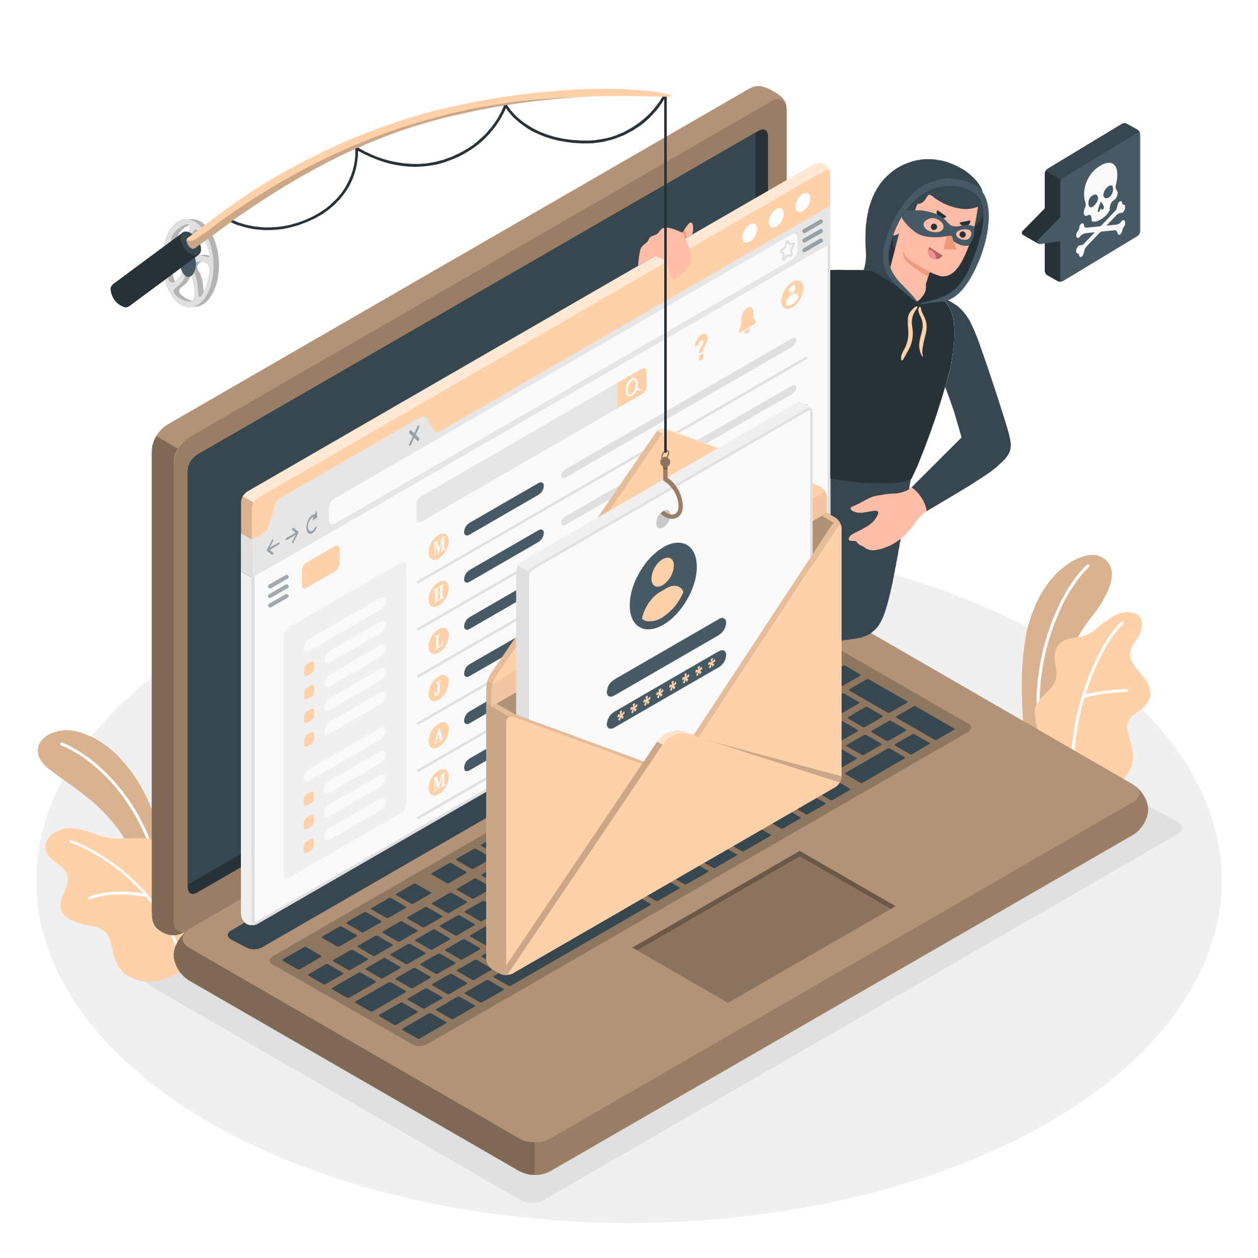
What is Phishing ?
“Phishing” refers to an attempt to steal sensitive information, typically in the form of usernames, passwords, credit card numbers, bank account information or other important data in order to utilize or sell the stolen information.
For example: Cybercriminals sent SMS messages that told recipients they should click a link to view important information about an upcoming USPS delivery. The malicious link actually took victims to various web pages designed to steal their Google account credentials.

Slide 4
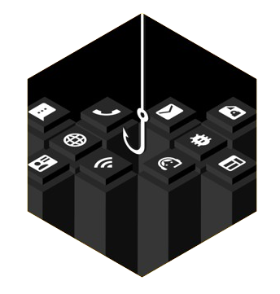
Common Types of Phishing Attacks
1. Email Phishing
- Fraudulent emails that seem to be from a legitimate source.
2. Spear Phishing
- Targeted phishing aimed at a specific individual or organization.
3. Whaling
- Targeting high-profile individuals like executives.
4. Smishing (SMS Phishing)
- Phishing via SMS or text messages.
5. Vishing (Voice Phishing)
- Phishing via voice calls.

Slide 5

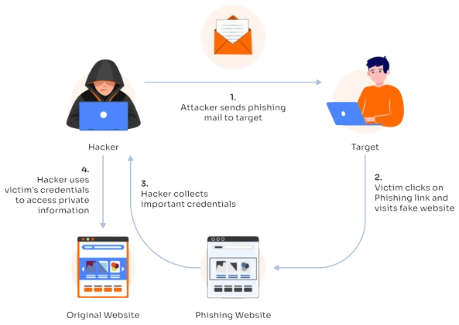

How does Phishing work ?
1.
Attacker sends phishing mail to target
Attacker
Target
4.
Hacker uses victim’s credentials to access private information
Phishing attacks use deceptive emails or messages from fake sources to trick individuals into providing sensitive information or downloading malware. Attackers exploit this data for unauthorized access or financial theft.
3.
Hacker collects important credentials
2.
Victim clicks on phishing link and visits false website
Original Website
Phishing Website

Slide 6
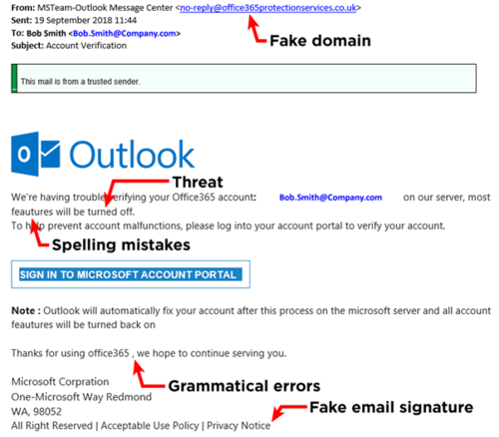
Recognizing Phishing Emails
A phishing email is an email that appears to be legitimate but is actually sent by threat actor with malicious intent.
Spotting email phishing:
Suspicious Sender – verify email address, look for misspellings or unfamiliar domains.
Urgent Language – be cautious of emails that create a sense of urgency or fear.
Suspicious Links – hover over links to see actual URL before clicking.
Unexpected Attachments – don’t open attachments from unknown or untrusted sources.
Poor Grammar and Spelling – professional organizations typically avoids such errors.

Slide 7
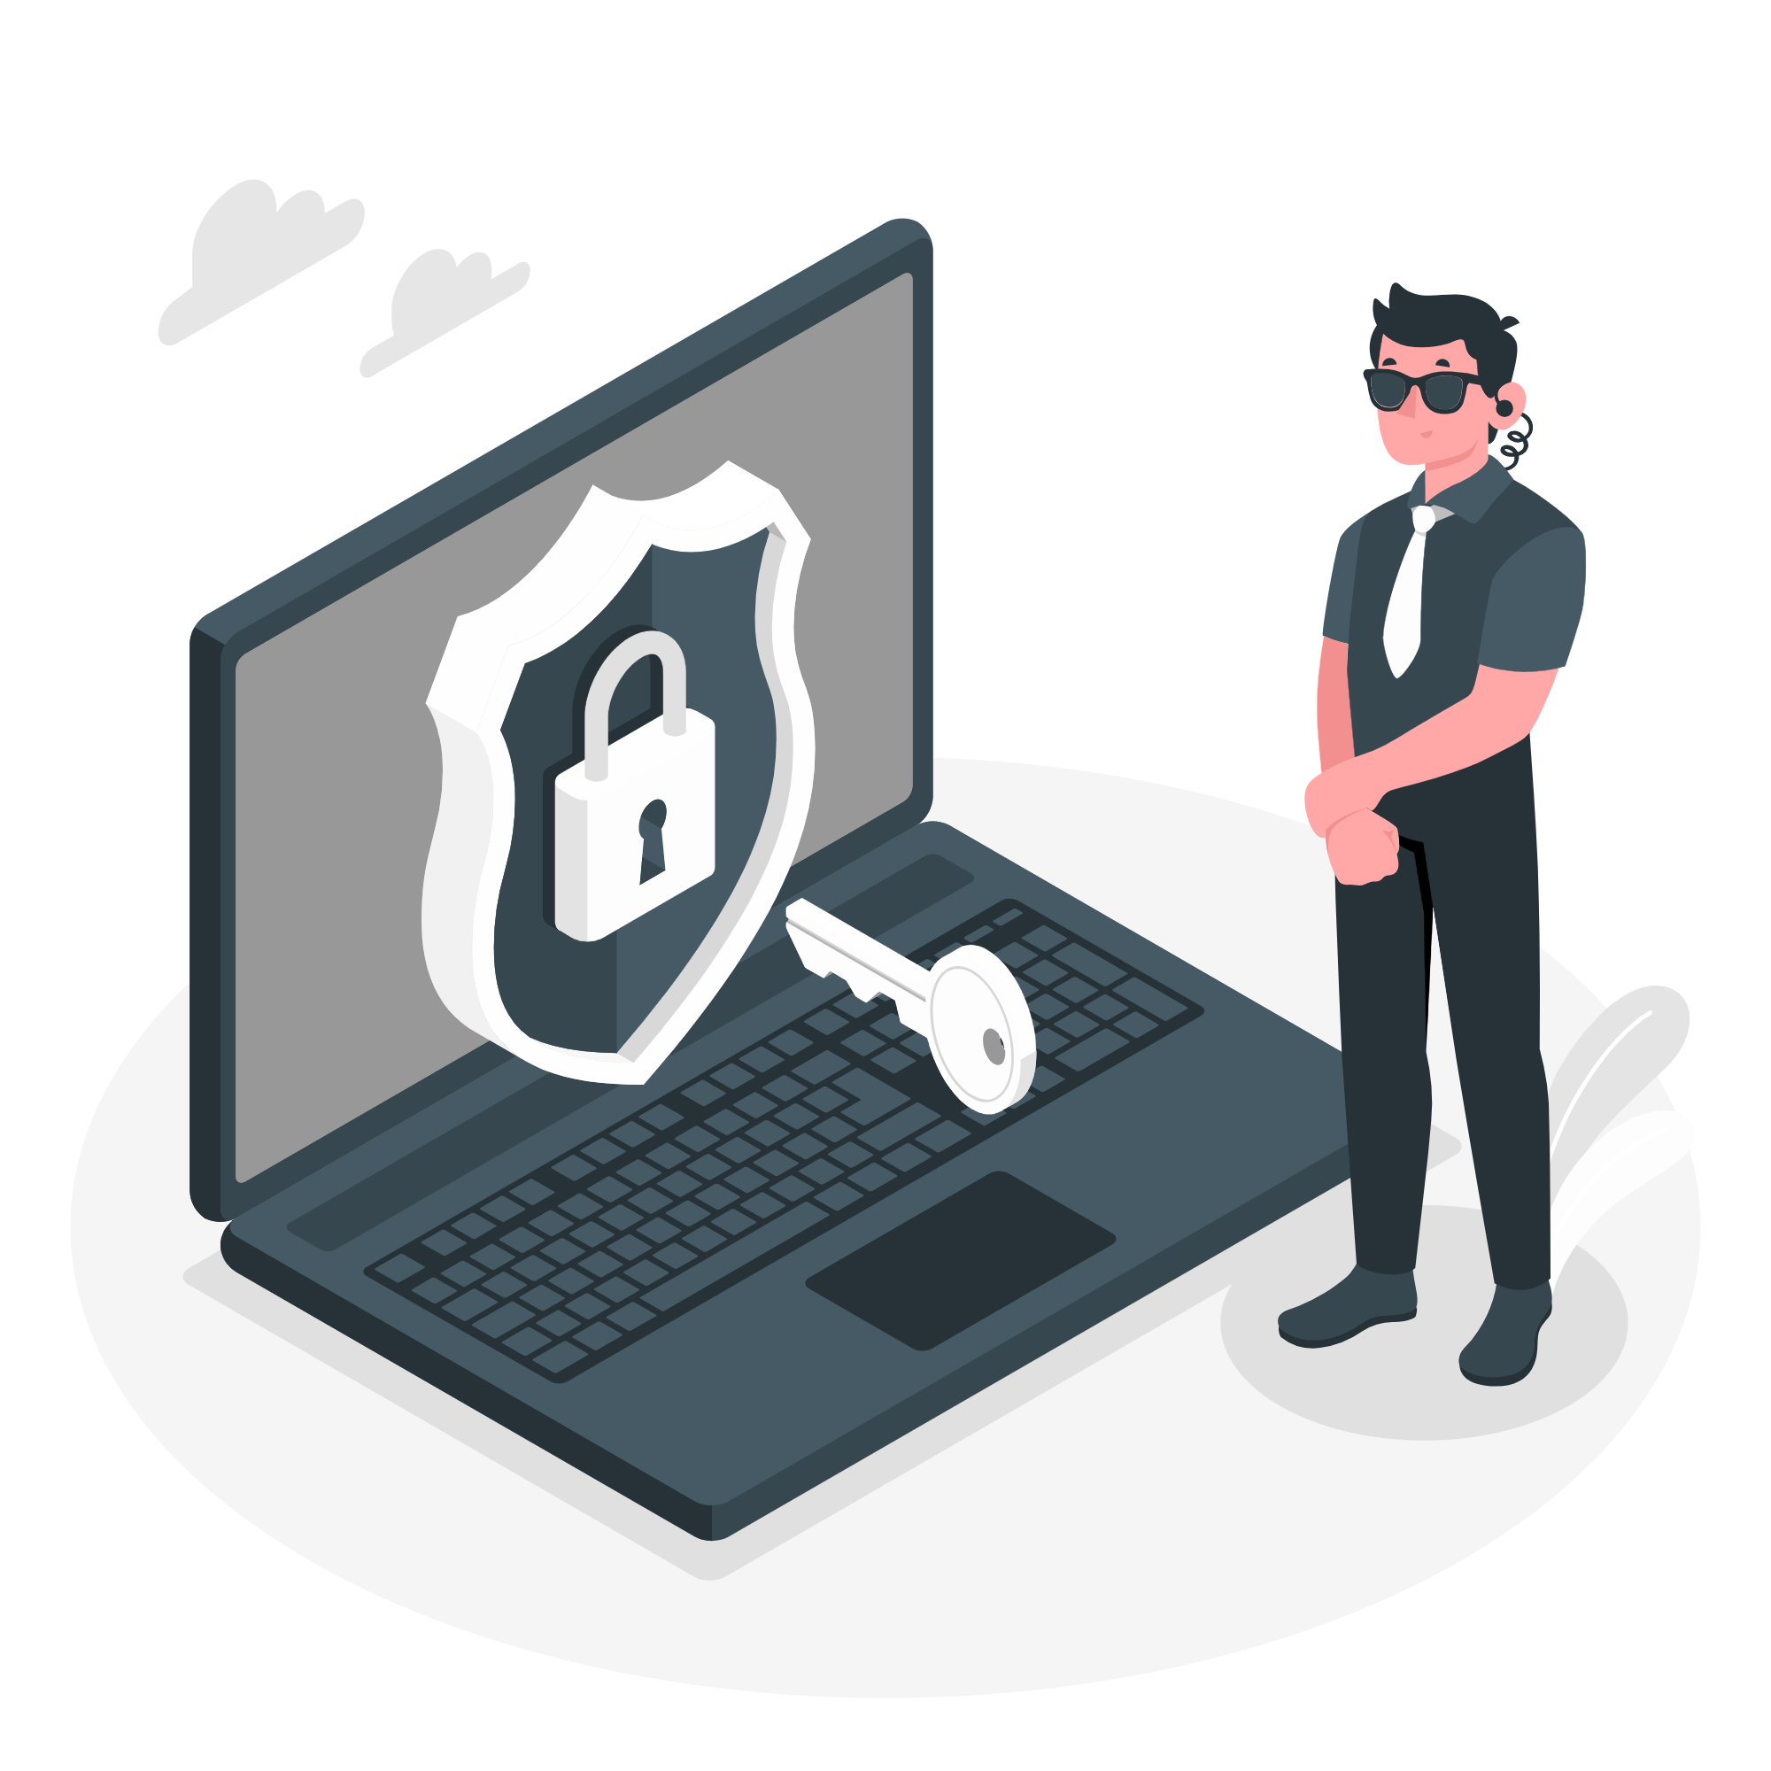
Prevention against Phishing Emails
If you suspect that the email you received is a phishing attempt then:
1
Verify sender, confirm email address and sender’s identity before responding.
2
Do not open it, avoid clicking on links in unsolicited emails.
3
Delete such emails immediately to avoid clicking or opening it accidentally.
4
Look for security indicators, check for ‘HTTPS’ in URLs and security certificates.
5
Report suspicious emails, use company protocols to report phishing attempt.
6
Use email filters and anti-phishing software.

Slide 8

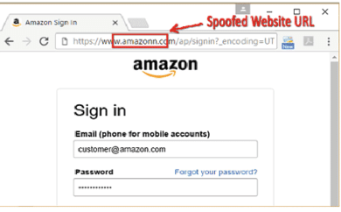
Detecting Phishing Websites
A phishing website is a common deception tactic, used by cybercriminals for malicious purposes, like credential theft or financial fraud.
Identifying:
Check URL – look for misspellings or unfamiliar domain.
Look for HTTPS – ensure sites are using ‘HTTPS’, indicating a secure connection.
Professional Appearance – be wary of websites with poor design, broken links or spelling errors.
Pop-up Requests – legitimate sites rarely use pop-ups to request personal information.

Slide 9
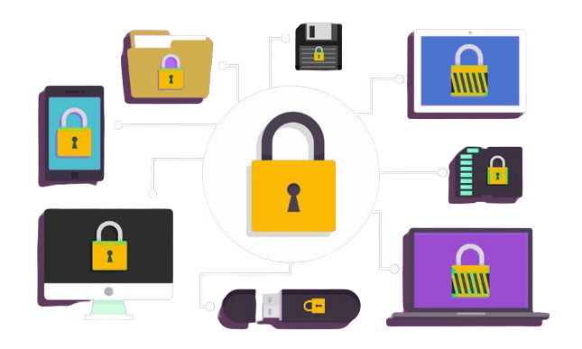

Avoiding Phishing Websites
Direct Access: Type URLs directly into the browser rather than clicking links, preventing landing on fake or unwanted websites.
Bookmark Trusted Sites: Use bookmarks to access frequently visited websites. For example – bookmarking bank’s official website.
Verify SSL Certificates: Check site’s security details thoroughly. For example – click the padlock icon on address bar to view certificate information.
Update Software: Ensure that the browsers and security software are up-to-date. For example – regular updates help protect against known vulnerabilities.

Slide 10
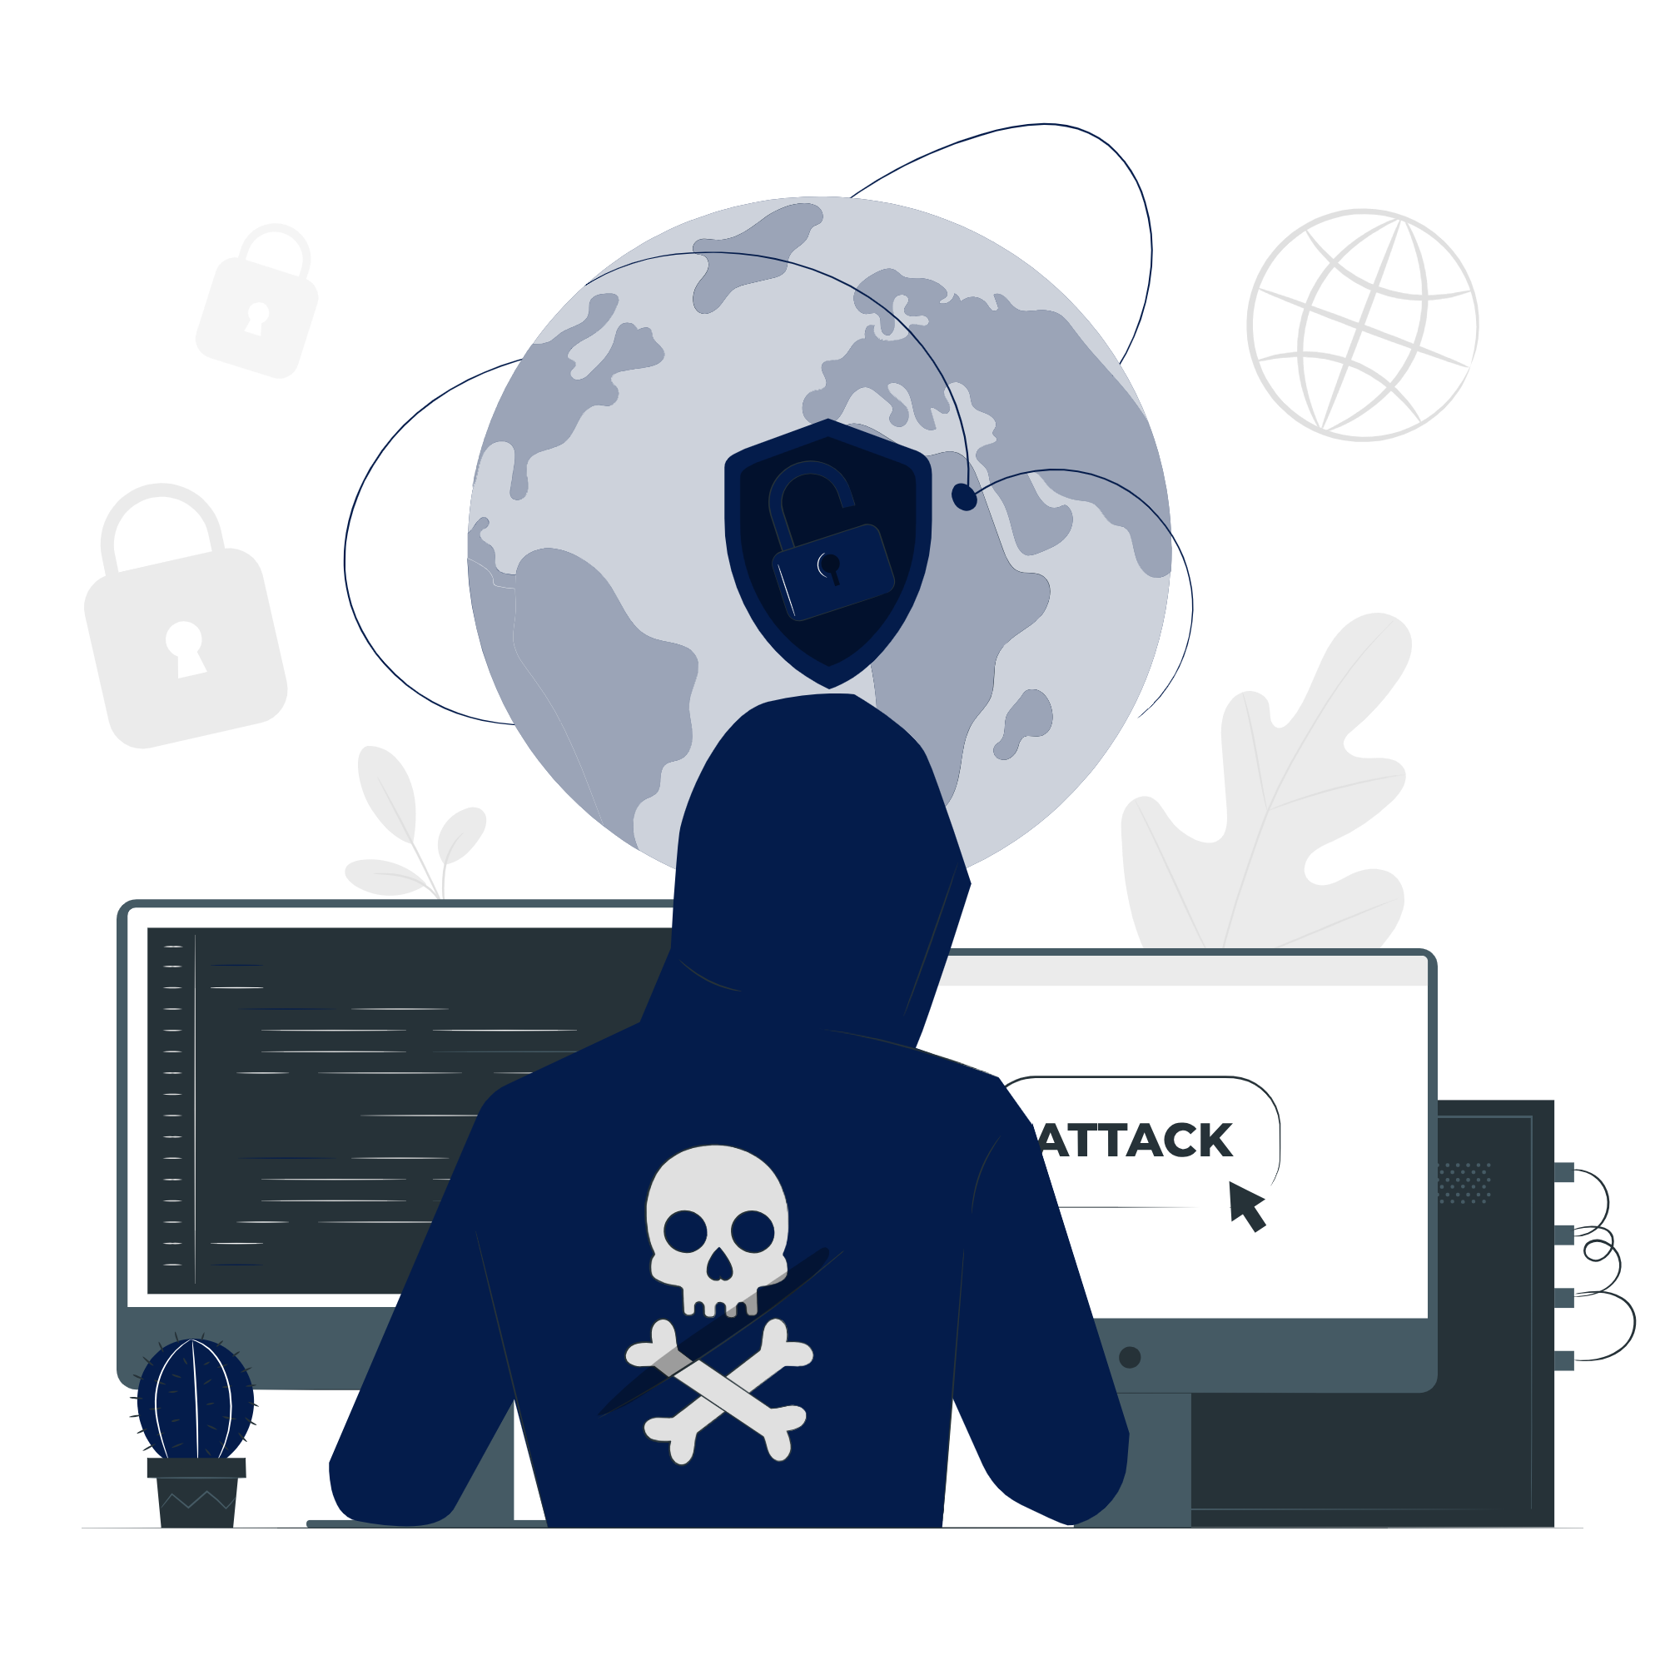

Social Engineering Tactics
Pretexting
Creating a fabricated scenario in order to obtain essential information.
For example – A caller pretending to be from your bank asking for account details.
Baiting
Offering something enticing to get someone to divulge information.
For example – A free USB drive left in public place that installs malware when used.
Tailgating
Following someone into a restricted area to gain access to personal information.
For example – An unauthorized person following an employee into a secure building.
Quid Pro Quo
Offering kind of service in exchange of some important document or information.
For example – A caller offering tech support in exchange for remote access to your computer.

Slide 11

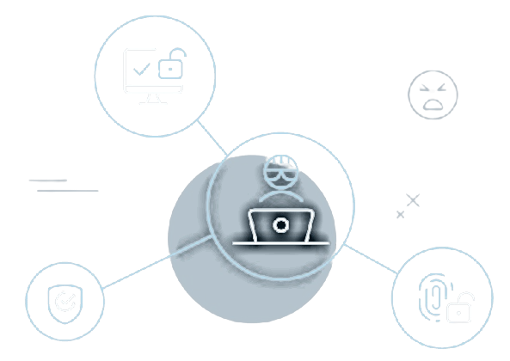
Protecting Against Social Engineering
Verify Identity:
- use Multi-factor authentication, always verify the identity of
someone requesting information.
Limit Information Sharing:
- be cautious about sharing personal or sensitive information.
Educate Employees:
- regular training on recognizing and reporting social engineering.
Implement Policies:
- establish strong policies and procedures for information security.

Slide 12

Case Study
Title: Phishing Attack on Financial Institution
Scenario:
A phishing email, designed to look like an official notice from the bank, was sent to customers. The email claimed that there was an issue with their account and instructed them to click on a link to verify their information. The link led to a fake website that collected their login credentials and personal information.
Impact:
Customers' personal information, including account details, was compromised.
Bank faced financial losses and damage to its reputation.
Lessons Learned:
Importance of verifying the authenticity of emails.
Necessity of customer education on recognizing phishing attempts.

Slide 13


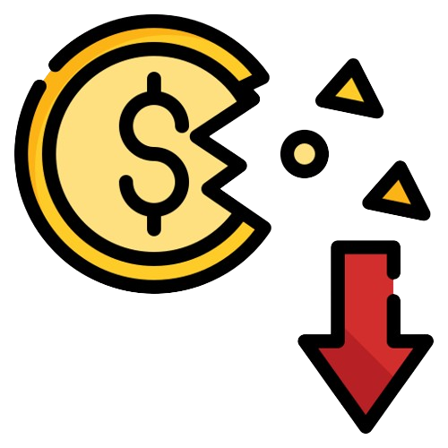

Impact of Phishing Attacks
Financial Loss: Victims can lose money directly through unauthorized transactions or through fraudulent activities conducted with stolen financial information.
Data Breach: Sensitive personal and corporate information can be compromised, leading to identity theft or corporate espionage.
Reputational Damage: Organizations suffer reputational damage, losing the trust of customers and partners, which can have long-term business implications.
Operational Disruption: Phishing attacks can disrupt normal business operations, requiring time and resources to address the breach.
Legal Consequences: Companies may face legal actions from customers or penalties from regulatory bodies for failing to protect sensitive information.
Emotional Distress: Victims experience stress and anxiety dealing with the consequences of the attack.

Slide 14
Phishing attacks are a prevalent and serious threat in the digital age, capable of causing significant financial loss, data breaches, and reputational damage. They exploit human vulnerabilities through deceptive emails and messages, tricking individuals into divulging sensitive information or downloading malicious software. To combat phishing, it is essential to prioritize education and awareness, implement robust security measures, and foster a culture of vigilance. Regular training, verification practices, and up-to-date security protocols are key defences against these attacks.
Conclusion

Slide 15
Thank You

